Slide 1
End Semester Presentation
on
SEGRINATOR
Presented By:
SUNIL KUMAR | (19BEM1004)
K NAZIA | (19BEM1009)
DIKSHA | (19BEM1026)
SHIVANSHH | (19BEM1051)
SUBJECT CODE-MTR-301
Session: Aug-Dec 2021
Project Supervisor
Mr. Inderpreet Singh (E1468)

Slide 2
Contents
Introduction
Literature Review
Project Objectives
Experimental Setup/Procedure
Work plan or Division/ Timeline
Present Work done (Work by each Team Member)
Pending Work
References

Slide 3
Introduction
Currently, garbage disposals have become quite problematic as segregating waste into various categories is also important. There are few who are knowledgeable in such related concepts but are quite lazy to do so, while there are also few who are clueless in such matters. With advancing technologies, the demand for smart homes is quite high, and as such the smart segregation concept comes to play an important role. Nobody wants to live in a messy or unhygienic place.
The garbage problem does not only lie in homes but also in the environment. We can hear some news regarding uncontrolled waste dumping on the corner of a neighborhood, or it could be the garbage accumulated on the beaches. Though there is active environmentalist helping clean out such places the problem all the more stops at segregating, waste separation is an important concept that cannot be overlooked as some are bio-degradable while some aren’t, some can be recycled and some cannot. Leaving them unattended can be harmful which is toxic to the environment. It could also lead to health problems such as asthma, cancer, infectious disease, and many more.

Slide 4
Literature review
S. No. | Author(s) | Title of study | Year Published
1 | Agarwal, Cherry | Automatic Waste Segregation and Management | 2020
2 | Dileep, J; Ashitha, S N A; Thoshitha, S N | Smart Waste Segregation using Arduino Uno | 2021
3 | Pandey, Mamta; Gowala, Anamika Goswami, Mrinal; Saikia, Chinmoy | Smart dustbin using arduino | 2020
4 | Aahash, G; Prasath, V Ajay; Gopinath, D; Electronics, M Gunasekaran; Engineering, Communication | Automatic Waste Segregator using Arduino | 2018

Slide 5
Project Objectives
Waste Segregation
Moisture Detection
Metal Detection
Dry Detection
Understanding of various sensors such as inductive proximity sensor, moisture sensor, touch sensor and IR sensor.
Understanding of Arduino Uno and Arduino IDE.

Slide 6
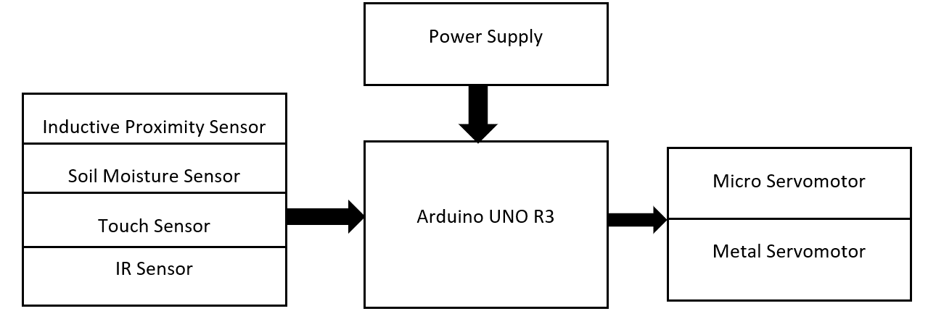
Block Diagram of Smart-Bin

Slide 7
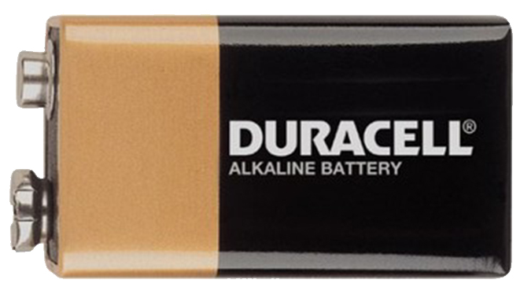
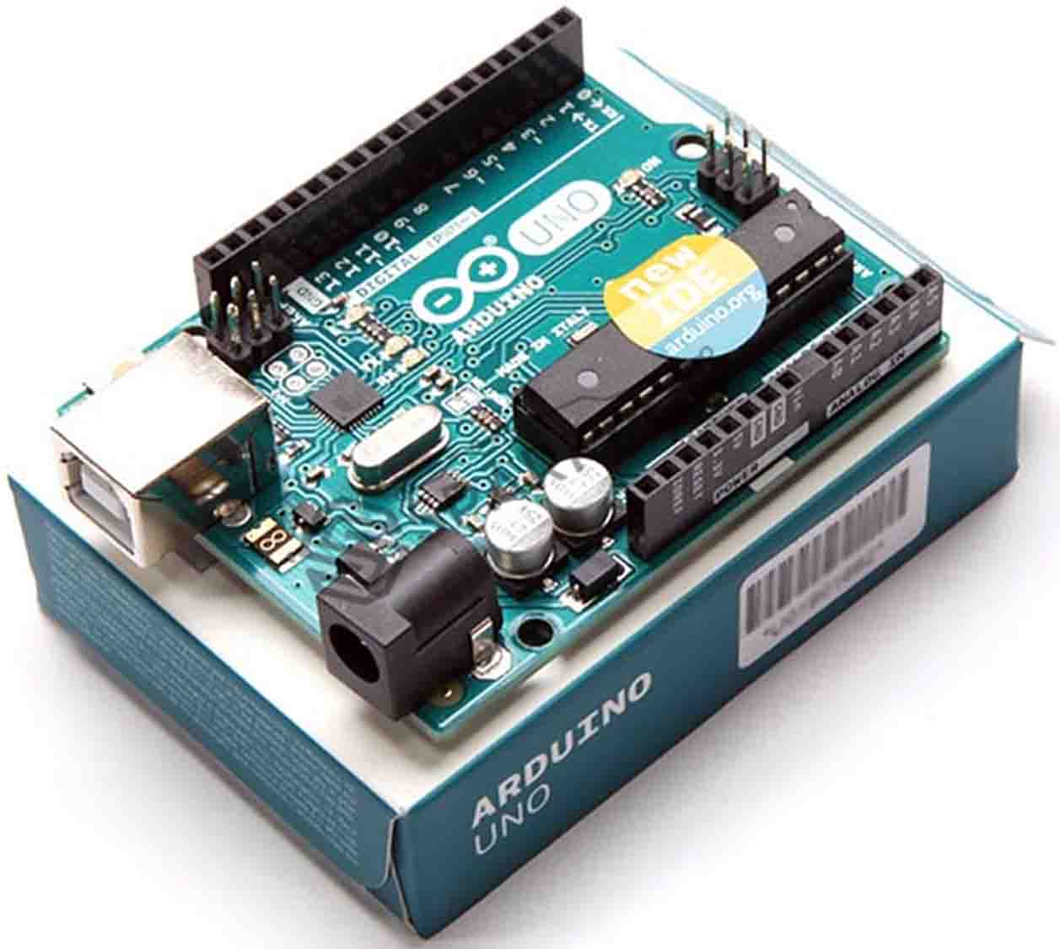
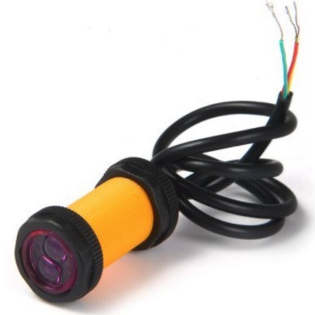
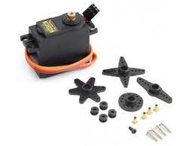
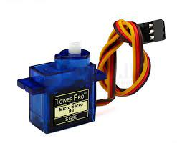
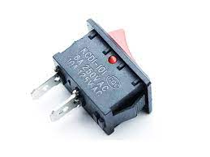
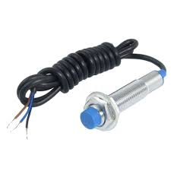
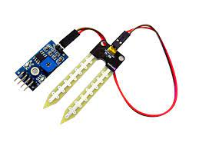
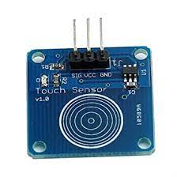
COMPONENTS USED
ARDUINO UNO R3 | IR SENSOR | SERVO MOTOR(s) | 9V BATTERY
CAPACITIVE TOUCH SENSOR | SOIL MOISTURE SENSOR SPST SWITCH |  | INDUCTIVE PROXIMITY SENSOR

Slide 8
Procedure
Segregation makes it attainable to utilize and recycle the waste effectively.
This waste segregator system can easily separate waste.
Waste is divided into three categories namely Wet, Dry and Metallic.
When waste is thrown in the pipe, before the opening of the door, the Arduino identifies the type of waste through the various sensors attached. the sensors will collect data as to what type of waste it is. Arduino provides certain instructions based on which servo motor rotates and as the door opens the waste is dropped in the allotted bins. The micro servo rotates open only when the metal servo take the desired position.

Slide 9
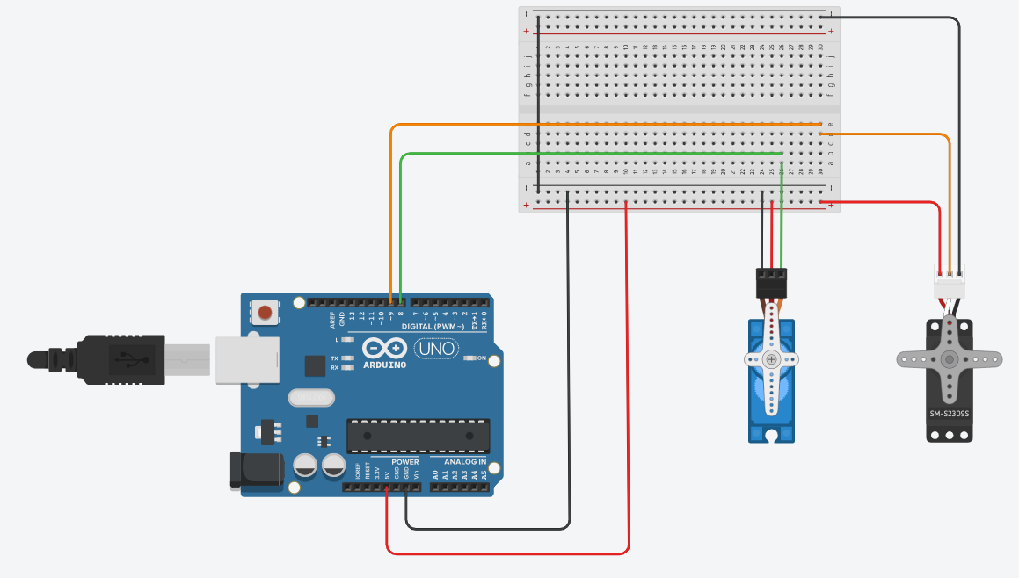
Circuit Diagram of the Smart-Bin
Circuit Diagram
Of
Servo Motors
28 December 2021
Department of Mechatronics' Engineering
9
Notes:
We have divided the circuit in 3 parts as for better understanding

Slide 10
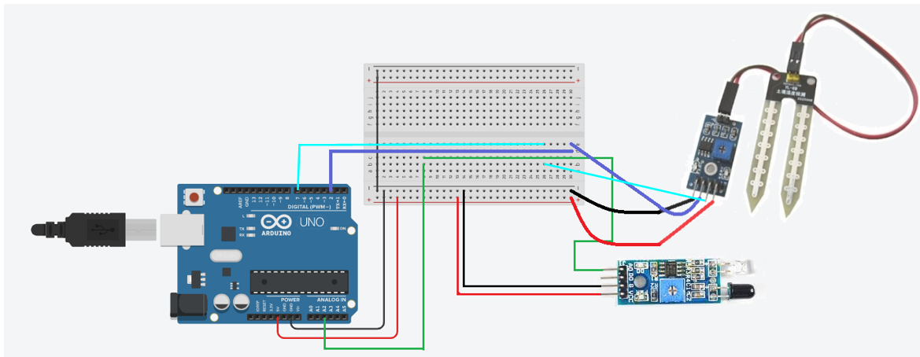
Circuit Diagram of IR Sensor and Moisture Sensor

Slide 11
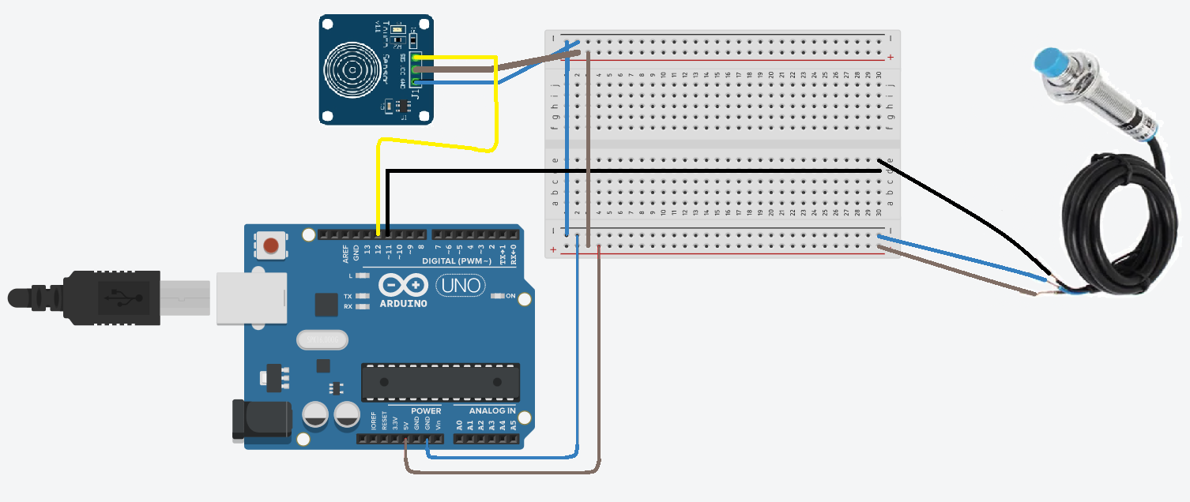
Circuit Diagram of Inductive Proximity Sensor and Touch Sensor

Slide 12
Process
Arduino is programmed using Arduino IDE. A board is placed on top of a metal servomotor to which 3 bins are attached. Metal servo has three fixed positions: 0º for Dry Bin, 90º for Metal Bin, and 180º for Wet Bin. The micro servomotor is used as an opening to the Bin. When any waste is detected, the micro servo rotates to 90º else stays closed that is positioned at 0º.
Once the programme is uploaded the Arduino starts working.
Initially, Arduino defaults metal servomotor on which the bins are mounted to 90º. and micro servomotor to 0º.
Firstly, metal detection is done using an inductive proximity sensor. Secondly, the moisture sensor detects if waste is wet or dry, the touch sensor also helps as an object identifier. For lightweight objects, we have used an IR sensor.
Notes:
Note: micro servo only rotates opens after metal servo has fixed to its desired position.

Slide 13
All the readings from each sensor are stored in a variable dedicated to each of them. Then the information is sent to the Arduino which then checks
If metal is detected, metal servo stays at 90º and micro servo rotates open.
If no metal but rather the moisture and touch sensor detect an object, the metal servo rotates 180º and the micro servo rotates open.
And if no metal and no moisture is detected but the IR sensor still detects an object then metal servo rotates to 0º and micro servo rotates open.
And when no object is detected then the micro servo remains closed
Since Arduino IDE keeps on running until the power supply is cut off. The above process keeps on repeating.

Slide 14
The following were used for testing:
WASTE | Metal-Bin | Wet- Bin | Dry- Bin
Nail | YES | - | -
Wet tissue | - | YES | -
Paper | - | - | YES
Pen | YES | - | -
Matchbox | - | - | YES

Slide 15
Work plan or Division/ Timeline
Firstly, after finalizing the project, we started working on the model design.
After finalizing the design, we noted the necessary equipment/components needed.
We then connected all the components and set them on the model stand and performed sample test.
We then went on to creating the final code and after completion fixed the components in place.

Slide 16
Present Work done (Work by each Team Member)
Work done by Sunil Kumar | Work done by Diksha
Physical Modelling Circuit Connection Synopsis Report | Project Design Project Presentation Research Paper
Work done by Nazia | Work done by Shivanshh
Research Paper Coding Project Presentation | Physical Modelling Circuit Connection Synopsis Report

Slide 17
References
[1] I. P. Sensor, ‘AUTOMATIC WASTE SEGREGATOR PROJECT REFERENCE NO : 38S012 8’.
[2] P. R. No, ‘WASTE SEGREGATION USING SMART DUSTBIN PROJECT REFERENCE NO .: 40S _ BE _ 0621 Introduction : Objectives ’:
[3] ‘SENSOR BASED SMART DUSTBIN FOR WASTE SEGREGATION AND STATUS ALERT’, no. 5, pp. 98–103, 2017.
[4] G. Aahash, V. A. Prasath, D. Gopinath, M. G. Electronics, and C. Engineering, ‘Automatic Waste Segregator using Arduino’, vol. 6, no. 07, pp. 6–8, 2018.
[5] N. S. Gupta, V. Deepthi, M. Kunnath, P. S. Rejeth, T. S. Badsha, and B. C. Nikhil, ‘Automatic Waste Segregation’, 2018 Second International Conference on Intelligent Computing and Control Systems (ICICCS), no. September 2020, pp. 1688–1692, 2018, doi: 10.1109/ICCONS.2018.8663148.
[6] C. Agarwal, ‘Automatic Waste Segregation and Management’, vol. 9, no. 06, pp. 715–718, 2020.
[7] ‘AUTOMATED WASTE SEGREGATION MACHINE’, vol. 8, no. 9, pp. 3068–3080, 2020.
[8] M. Pandey, A. Gowala, M. Goswami, and C. Saikia, ‘Smart dustbin using arduino’, no. August, 2020.
[9] E. Malleswari and S. N. Kishore, ‘Smart Wastage Segregation using Arduino UNO’, no. 5, pp. 2074–2078, 2020, doi: 10.35940/ijrte.E5734.018520.
[10] J. Dileep, S. N. A. Ashitha, and S. N. Thoshitha, ‘Smart Waste Segregation using Arduino Uno’, vol. 8, no. 8, pp. 472–475, 2021, doi: 10.17148/IARJSET.2021.8878.

Slide 18
THANK YOU

